Slide 1
ALTRES ARBRES
SÍLVIE ROTHKOVIC

Slide 2
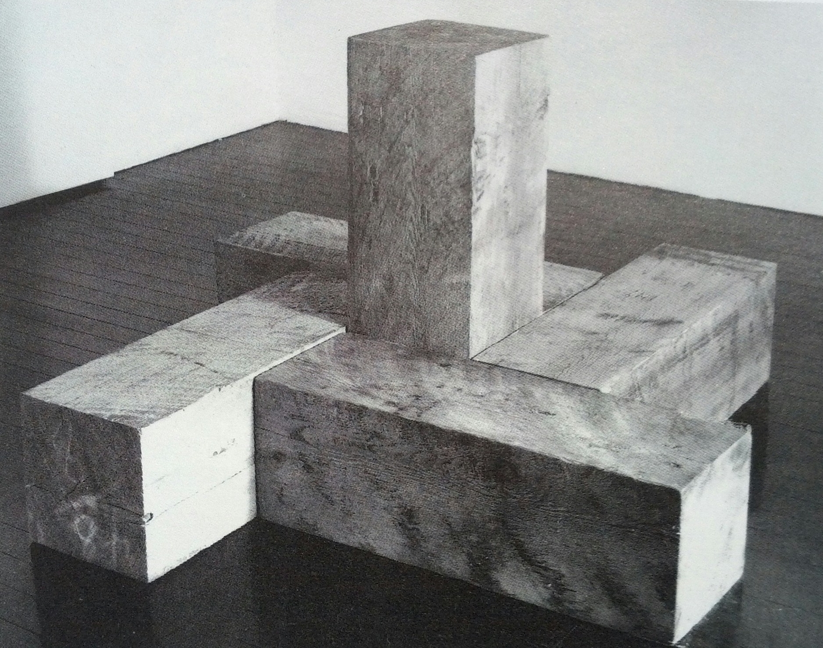
CARL ANDRÉ
The Way North, East, South, West
79

Slide 3
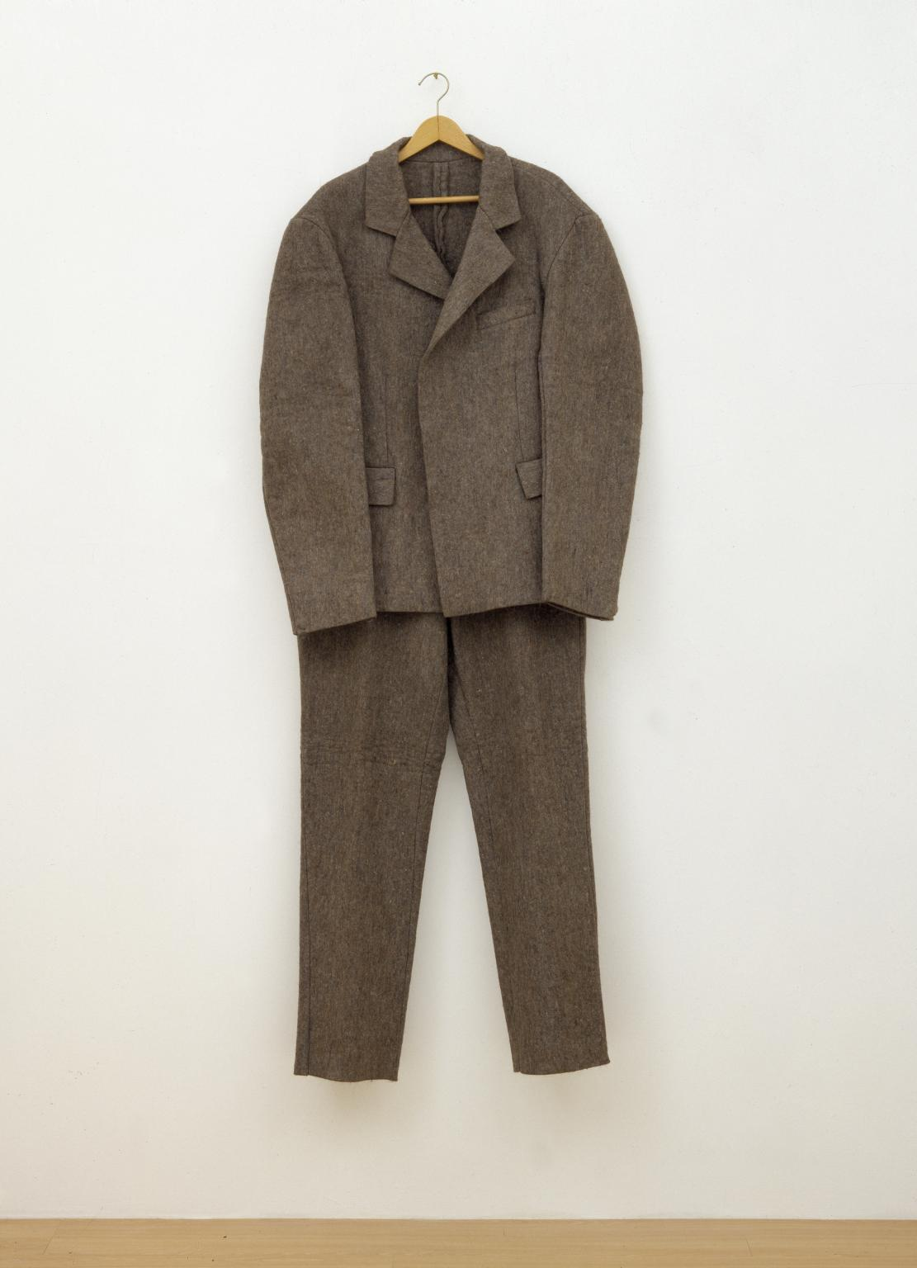
JOSEPH BEUYS
Felt Suit
71

Slide 4
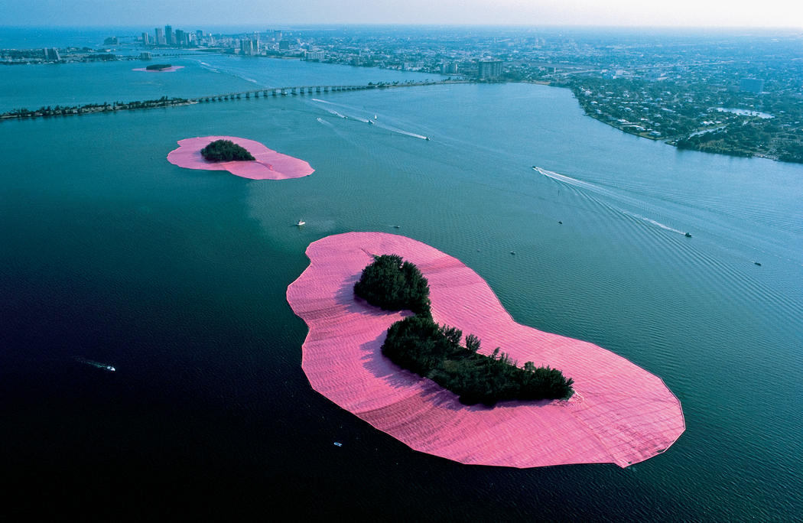
CHRISTO I JEAN-CLAUDE
Surrounded Islands
21

Slide 5
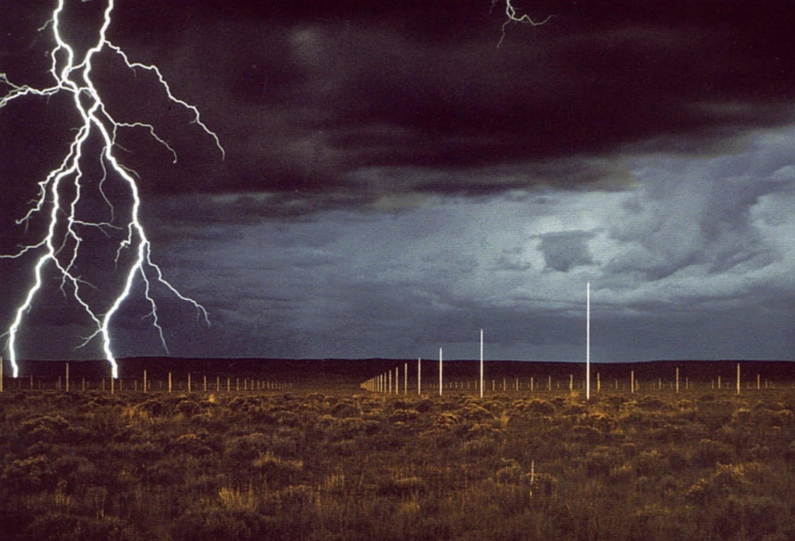
WALTER DE MARIA
The Lightning Field
23

Slide 6
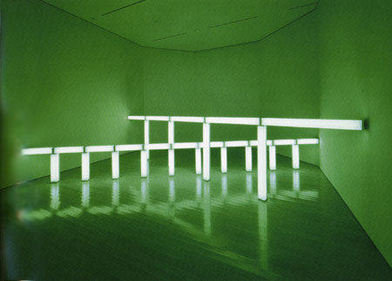
JAN DIBBETS
Greens Crossing Greens
66

Slide 7
HENRYK GÓRECKI
Largo cantabile
51
https://www.youtube.com/watch?v=1zWZo4lo4VM

Slide 8
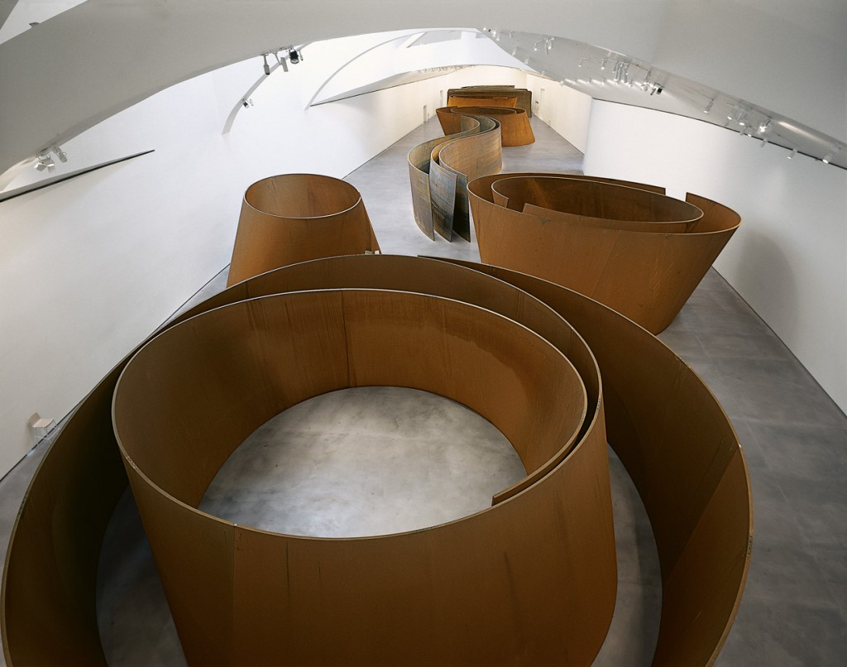
RICHARD SERRA
The Matter of Time
83

Slide 9
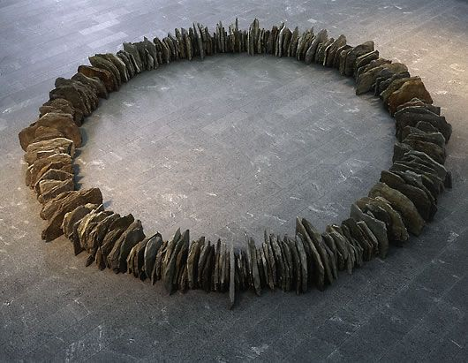
RICHARD LONG
Earthquake Circle
50

Slide 10
ARVO PÄRT
Spiegel im Spiegel
42
https://www.youtube.com/watch?v=TJ6Mzvh3XCc

Slide 11
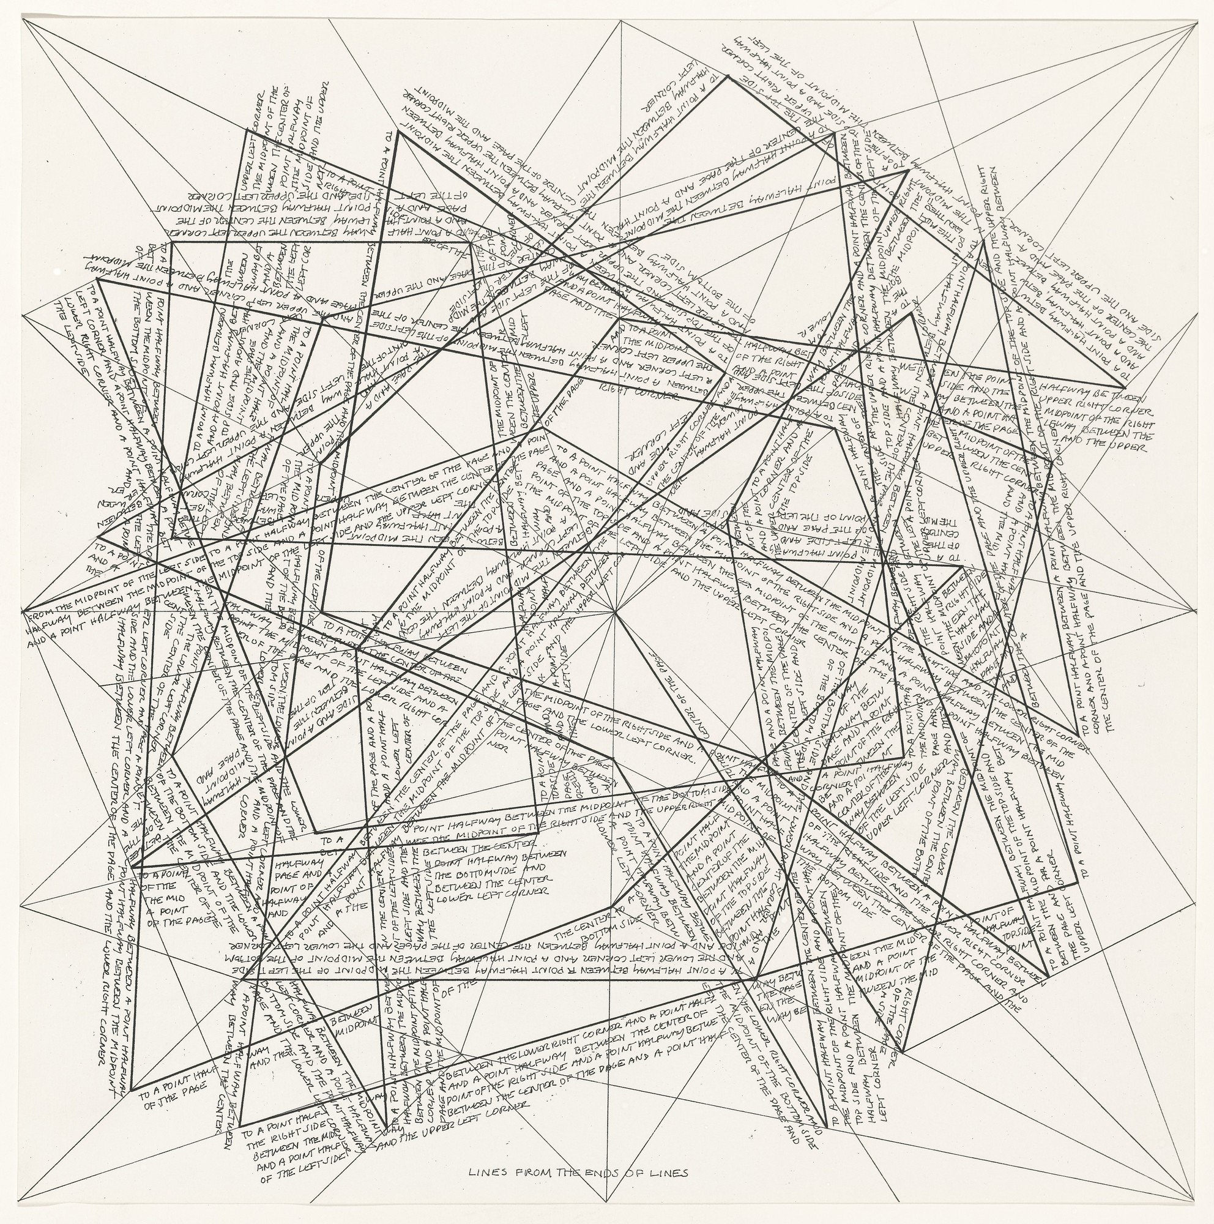
SOL LEWITT
The Location of Lines
58

Slide 12
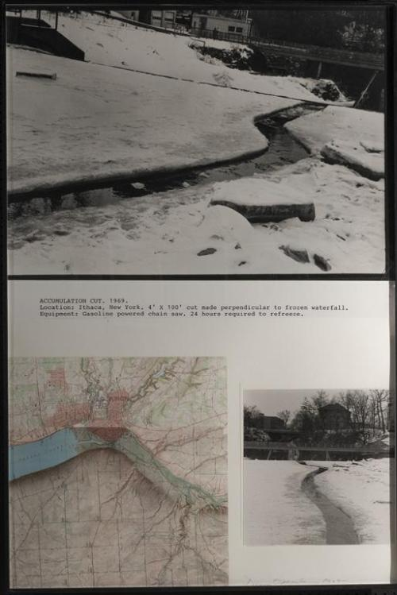
DENNIS OPPENHEIM
Acumulation, cut
34

